Slide 1

Lecture # 1
Introduction
Dr. Abdulhussein M. Abdullah
1st semester 2018-2019
Computer Science Dept., College of CS & IT, Basrah University

Slide 2
BOOKS
John Domingue, Dieter Fensel, James A.Hendler, Handbook of Semantic Web Technologies, 2011
Toby Segaran, Programming the Semantic Web, 2009

Slide 3
Outlines
Internet
Web
Web Principles
Web Limitations
Semantic

Slide 4
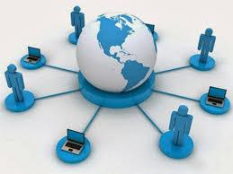
Internet
The Internet is a global system of interconnected computer networks that use the standard Internet Protocol Suite (TCP/IP) to serve billions of users worldwide.
It is a network of networks that consists of millions of private and public, academic, business, and government networks of local to global scope that are linked by a broad array of electronic and optical networking technologies.

Slide 5
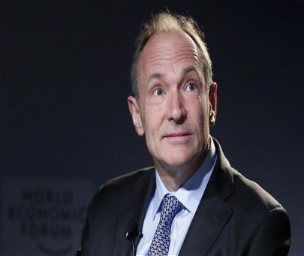
WEB
it was created by Tim Berners-Lee during the period 1989-1991 at CERN
At a basic level, the Web is an application developed to let people share information over the Internet.
CERN: The European Particle Physics Laboratory in Geneva

Slide 6
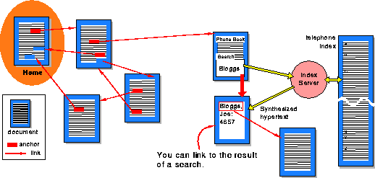
The World Wide Web
is a system of interlinked, hypertext documents that runs over the Internet.
With a Web browser, a user views Web pages that may contain text, images, and other multimedia and navigates between them using hyperlinks.
- wikipedia

Slide 7
World Wide Web
AAA principle = Anybody can write Anything about Any topic
Basic building block is a web page
Any web page can refer to any other web page freely
No central point of control
No central repository => Documents scattered across the whole Web

Slide 8

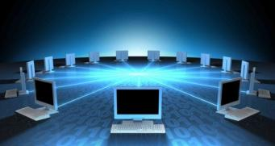
Problem:
Web page is a document for
For (machines) web pages
are too difficult to understand

Slide 9
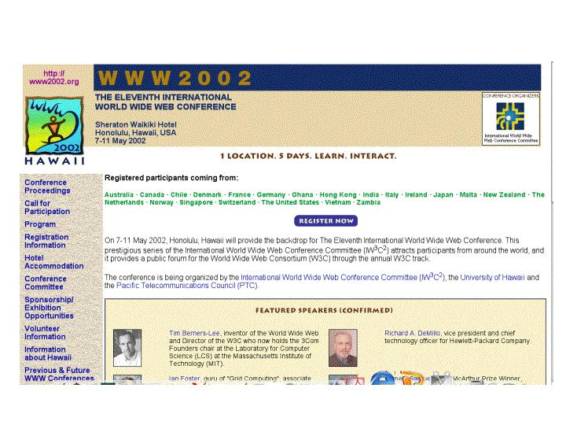
What is the Problem?
Consider a typical web page:
Markup consists of:
  rendering information (e.g., font size and colour)
  Hyper-links to related content
Semantic content is accessible to humans but not (easily) to computers…

Slide 10
What information can we see…
WWW2002
The eleventh international world wide web conference
Sheraton waikiki hotel
Honolulu, hawaii, USA
7-11 may 2002
1 location 5 days learn interact
Registered participants coming from
australia, canada, chile denmark, france, germany, ghana, hong kong, india, ireland, italy, japan, malta, new zealand, the netherlands, norway, singapore, switzerland, the united kingdom, the united states, vietnam, zaire
Register now
On the 7th May Honolulu will provide the backdrop of the eleventh international world wide web conference. This prestigious event …
Speakers confirmed
Tim berners-lee
Tim is the well known inventor of the Web, …
Ian Foster
Ian is the pioneer of the Grid, the next generation internet …

Slide 11
What information can a machine see…
WWW2002
The eleventh international world wide web conference
Sheraton waikiki hotel
Honolulu, hawaii, USA
7-11 may 2002
1 location 5 days learn interact
Registered participants coming from
australia, canada, chile denmark, france, germany, ghana, hong kong, india, ireland, italy, japan, malta, new zealand, the netherlands, norway, singapore, switzerland, the united kingdom, the united states, vietnam, zaire
Register now
On the 7th May Honolulu will provide the backdrop of the eleventh international world wide web conference. This prestigious event …
Speakers confirmed
Tim berners-lee
Tim is the well known inventor of the Web, …
Ian Foster
Ian is the pioneer of the Grid, the next generation internet …

Slide 12
Solution: XML markup with “meaningful” tags?
<name>WWW2002
The eleventh international world wide webcon</name>
<location>Sheraton waikiki hotel
Honolulu, hawaii, USA</location>
<date>7-11 may 2002</date>
<slogan>1 location 5 days learn interact</slogan>
<participants>Registered participants coming from
australia, canada, chile denmark, france, germany, ghana, hong kong, india, ireland, italy, japan, malta, new zealand, the netherlands, norway, singapore, switzerland, the united kingdom, the united states, vietnam, zaire</participants>
<introduction>Register now
On the 7th May Honolulu will provide the backdrop of the eleventh international world wide web conference. This prestigious event …
Speakers confirmed</introduction>
<speaker>Tim berners-lee</speaker>
<bio>Tim is the well known inventor of the Web,</bio>…

Slide 13
But What About…
<conf>WWW2002
The eleventh international world wide webcon</conf>
<place>Sheraton waikiki hotel
Honolulu, hawaii, USA</place>
<date>7-11 may 2002</date>
<slogan>1 location 5 days learn interact</slogan>
<participants>Registered participants coming from
australia, canada, chile denmark, france, germany, ghana, hong kong, india, ireland, italy, japan, malta, new zealand, the netherlands, norway, singapore, switzerland, the united kingdom, the united states, vietnam, zaire</participants>
<introduction>Register now
On the 7th May Honolulu will provide the backdrop of the eleventh international world wide web conference. This prestigious event …
Speakers confirmed</introduction>
<speaker>Tim berners-lee</speaker>
<bio>Tim is the well known inventor of the Web,…

Slide 14
Machine sees…
<name>WWW2002
The eleventh international world wide webc</name>
<location>Sheraton waikiki hotel
Honolulu, hawaii, USA</location>
<date>7-11 may 2002</date>
<slogan>1 location 5 days learn interact</slogan>
<participants>Registered participants coming from
australia, canada, chile denmark, france, germany, ghana, hong kong, india, ireland, italy, japan, malta, new zealand, the netherlands, norway, singapore, switzerland, the united kingdom, the united states, vietnam, zaire</participants>
<introduction>Register now
On the 7th May Honolulu will provide the backdrop of the eleventh international world wide web conference. This prestigious event …
Speakers confirmed</introduction>
<speaker>Tim berners-lee</speaker>
<bio>Tim is the well known inventor of the W</bio>
<speaker>Ian Foster</speaker>
<bio>Ian is the pioneer of the Grid, the ne</bio>

Slide 15
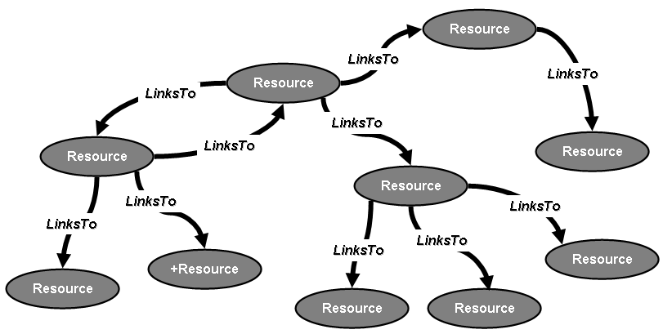
The set of pages on the Web thereby becomes a graph
The nodes are the pages themselves
The directed edges are the links that lead from one page to another.

Slide 16
Web principles
The success of Web1.0 is based on three simple principles:
  A simple and uniform addressing schema to indentify information chunks i.e. Uniform Resource Identifiers (URIs)
  A simple and uniform representation formalism to structure information chunks allowing browsers to render them i.e. Hyper Text Markup Language (HTML)
  A simple and uniform protocol to access information chunks i.e. Hyper Text Transfer Protocol (HTTP)

Slide 17
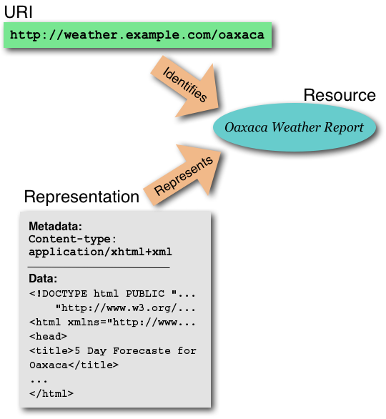

Slide 18
Uniform Resource Identifiers (URIs) are used to name/identify resources on the Web
URIs are pointers to resources to which request methods can be applied to generate potentially different responses
Resource can reside anywhere on the Internet
Most popular form of a URI is the Uniform Resource Locator (URL)

Slide 19
Hyper-Text Markup Language:
  A subset of Standardized General Markup Language (SGML)
  Facilitates a hyper-media environment
Documents use elements to “mark up” or identify sections of text for different purposes or display characteristics
HTML markup consists of several types of entities, including: elements, attributes, data types and character references
Markup elements are not seen by the user when page is displayed
Documents are rendered by browsers

Slide 20
Limitations of the current Web
The current Web has its limitations when it comes to:
  finding relevant information
  extracting relevant information
  combining and reusing information

Slide 21


Limitations of the current Web
Finding relevant information
Finding information on the current Web is based on keyword search
Keyword search has a limited recall and precision due to:
  Synonyms:
    e.g. Searching information about “Cars” will ignore Web pages that contain the word “Automobiles” even though the information on these pages could be relevant
  Homonyms:(one of a group of words that share the same spelling and the same pronunciation but have different meanings)
    e.g. Searching information about “Jaguar” will bring up pages containing information about both “Jaguar” (the car brand) and “Jaguar” (the animal) even though the user is interested only in one of them

Slide 22
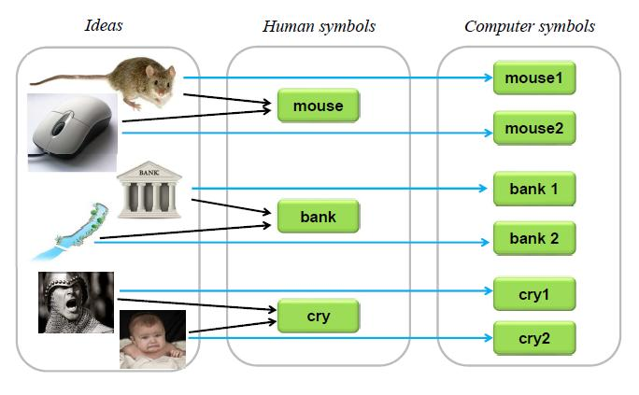

Slide 23
Disambiguity of referencing to things:
– Example: mouse, windows, cry, …
– Every thing should have its unique name
– Solution: URIs (Uniform Resource Identifiers)
Disambiguity of concepts
– Example:
• John is attracted to Mary.
• North pole is attracted to south pole.
– There has to be some common understanding of the domain
in question
– Solution: Ontology – a precise explanation of terms and
reasoning in a subject area.

Slide 24
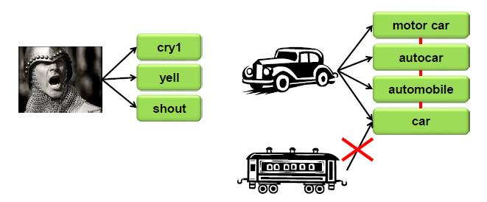
Non-unique Naming Assumption
Some resource (abstract idea or concrete thing) may have several names
We have to explicitly tell the computer that these names mean the same thing

Slide 25
Limitations of the current Web
Finding relevant information
Keyword search has a limited recall and precision due also to:
  Spelling variants:
    e.g. “organize” in American English vs. “organise” in British English
  Spelling mistakes
  Multiple languages
    i.e. information about same topics in published on the Web on different languages (English, German, Italian,…)
Current search engines provide no means to specify the relation between a resource and a term
  e.g. sell / buy

Slide 26
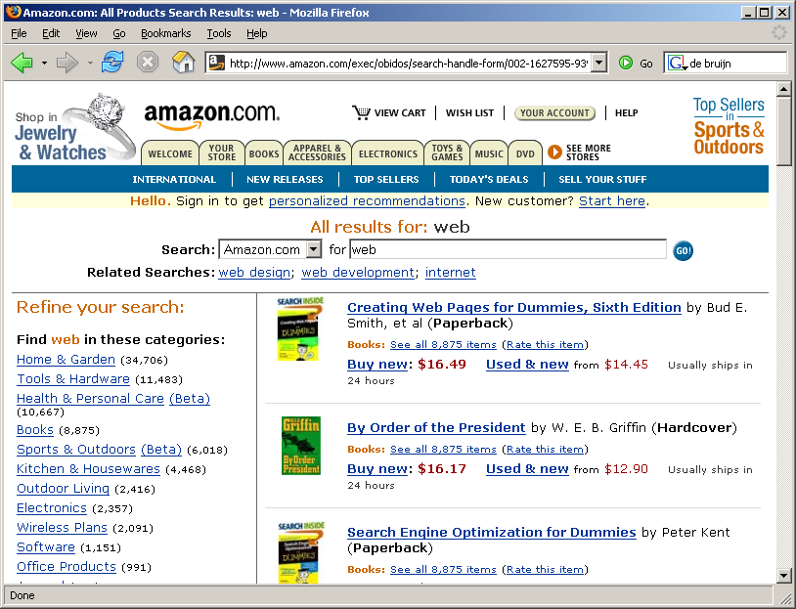
Limitations of the current Web
Extracting relevant information
One-fit-all automatic solution for extracting information from Web pages is not possible due to different formats, different syntaxes
Even from a single Web page is difficult to extract the relevant information
Which book is
about the Web?
What is the price
of the book?

Slide 27
Limitations of the current Web
Extracting relevant information
The actual extraction of information from web sites is specified using standards such as XSL Transformation (XSLT) [1]
Extracted information can be stored as structured data in XML format or databases.
However, using wrappers do not really scale because the actual extraction of information depends again on the web site format and layout

Slide 28
Limitations of the current Web
Combining and reusing information
Tasks often require to combine data on the Web
  Searching for the same information in different digital libraries
  Information may come from different web sites and needs to be combined

Slide 29

Limitations of the Web today
Machine-to-human, not machine-to-machine

Slide 30


Summarizing the Problem:
Computers don’t understand Meaning
“My mouse is broken. I need a new one…”
Use of ontology
“My mouse is broken” vs. “My mouse is dead”

Slide 31
The Solution
WWW
URI, HTML, HTTP
Semantic Web
RDF, RDF(S), OWL

Slide 32
What is semantics
An evolving development of the WWW in which the meaning(Semantics) of information and services on the web is defined, making it possible for the web to “understand” and satisfy the requests of people and machines to use the web contents.

Slide 33
What for semantics is?
Identification
Recognition
Evaluation
Decision making
Control
Thinking, reasoning, discovery
Communication
Utilization
Self-management
… a lot more!

Slide 34


Need for Semantics (example): 1
He says:
“I love you! Be my wife!”

Slide 35

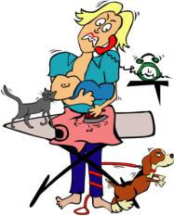
Need for Semantics (example): 2
He means:

Slide 36
Need for Semantics (example): 3
She hears:
“I love you! Be my wife!”

Slide 37

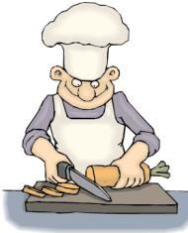
Need for Semantics (example): 4
She means:

Slide 38
Need for Semantics (example): 5
He may say it in many ways:
“I love you! Be my wife!”
“I am in love with you! Would you marry me!”
“Я люблю тебя! Выходи за меня замуж!”
“我爱你！请问你愿意嫁给我吗!”
أحبك! هل تتزوجني؟
“Rakastan sinua, olisit vaimokseni”

Slide 39
Need for Semantics (example): 6
… but still, he means:
39

Slide 40
Need for Semantics (example): 7
She may be able to hear all of these and may know all these languages:
“I love you! Be my wife!”
“I am in love with you! Would you marry me!”
“Я люблю тебя! Выходи за меня замуж!”
“我爱你！请问你愿意嫁给我吗!”
أحبك! هل تتزوجني؟
“Rakastan sinua, olisit vaimokseni”
40

Slide 41
Need for Semantics (example): 8
…however still she means:
41

Slide 42
Need for Semantics (example): 9
This would be really a hard task to automate such a connection !
“I love you! Be my wife!”

Slide 43
Need for Semantics (example): 10
This would be really a hard task to automate any of these connections as well!
“I love you! Be my wife!”
“I am in love with you! Would you marry me!”
“我爱你！请问你愿意嫁给我吗!”
43

Slide 44



Need for Semantics (example): 11
Formal explicit representations of the meaning
However to automatically discover meaning of such a connection is doable!

Slide 45


Need for Semantics (example): 12
Now he says explicitly:
45

Slide 46
Need for Semantics (example): 13
Sorry honey! Find another fool !!!
Now she understood!
46

Slide 47
Semantic Web: New “Users”
applications
agents

Slide 48
Semantic Web: Annotations
applications
agents
Semantic annotations are specific sort of metadata, which provides information about particular domain objects, values of their properties and relationships, in a machine-processable, formal and standardized way.

Slide 49
Semantic Web: Ontologies
applications
agents
Ontologies make metadata interoperable and ready for efficient sharing and reuse. It provides shared and common understanding of a domain, that can be used both by people and machines. Ontologies are used as a form of agreement-based knowledge representation about the world or some part of it and generally describe: domain individuals, classes, attributes, relations and events.

Slide 50
Semantic Web: Rules
applications
agents
Logical support in form of rules is needed to infer implicit content, metadata and ontologies from the explicit ones. Rules are considered to be a major issue in the further development of the semantic web. On one hand, they can be used in ontology languages, in conjunction with or as an alternative to description logics. And on the other hand, they will act as a means to draw inferences, to configure systems, to express constraints, to specify policies, to react to events/changes, to transform data, to specify behavior of agents, etc.

Slide 51
Semantic Web: Languages
applications
agents
Languages are needed for machine-processable formal descriptions of: metadata (annotations) like e.g. RDF; ontologies like e.g. OWL.; rules like e.g. RuleML. The challenge is to provide a framework for specifying the syntax (e.g. XML) and semantics of all of these languages in a uniform and coherent way. The strategy is to translate the various languages into a common 'base' language (e.g. CL or Lbase) providing them with a single coherent model theory.

Slide 52
Semantic Web: Tools
applications
agents
User-friendly tools are needed for metadata manual creation (annotating content) or automated generation, for ontology engineering and validation, for knowledge acquisition (rules), for languages parsing and processing, etc.

Slide 53
Semantic Web: Applications and Services
Utilization of Semantic Web metadata, ontologies, rules, languages and tools enables to provide scalable Web applications and Web services for consumers and enterprises" making the web 'smarter' for people and machines.
applications
agents

Slide 54

Semantic Web: Resource Integration
Semantic annotation
Shared ontology
Web resources / services / DBs / etc.

Slide 55


Semantic Web: which resources to annotate ?
Industrial and business processes
External world resources
Web resources / services / DBs / etc.
Web users (profiles, preferences)
Shared ontology
Multimedia resources
Web agents / applications
Web access devices
Smart machines and devices

Slide 56
In order to meet this requirement, the technology must be capable of:
• Retrieving large amounts of textual data quickly.
• Allowing users to add annotations so that a reasoning capability exists.
• Making text retrieval more specific.
• Allowing conclusions to be drawn by data on the Web and across organizations.

Slide 57
FOUR COMPONENTS OF THE SEMANTIC WEB
URI – UNIFORM RESOURCE IDENTIFIER
URI’s are simple web identifiers that are often found on the World Wide Web (i.e. http, ftp). The Semantic Web is structured around syntaxes which utilize URI’s as a naming convention to represent data
.
RDF – RESOURCE DESCRIPTION FRAMEWORK
RDF is used by The Semantic Web to describe data, thus allowing it to be shared more conveniently. It enables software developers to design products that will deploy better search engines by utilizing the metadata. As a result, users have more control over what they are viewing. Additionally, RDF is vocabulary agnostic which creates an interoperable environment capable of supporting a diverse range of ontologies.

Slide 58
(Cont)
RDF SCHEMA
The RDF Schema is a language used by The Semantic Web to describe the data properties used in RDF.
ONTOLOGIES
An ontology differs from traditional web schema in that it represents knowledge, not just a message format. The Semantic Web utilizes OWL, a web ontology language used by applications that need to process data rather than just display it. Semantic Web uses OWL to add reason to data by identifying and describing relationships between data items. OWL ontologies are capable of processing the content of information, rather than just presenting the data to users.

Slide 59
